Slide 1
Community Eligibility PROVISION for central office staff
Provided by the LAUSD Food Services Division
Notes:
TELL: THIS IS JUST A PLACE HOLDER FOR SCREEN BEFORE THE PRESENTATION IS READY TO BEGIN

Slide 2

Community Eligibility PROVISION for central office staff
Provided by the LAUSD Food Services Division
Notes:
TELL: Welcome to the Community Eligibility Provision training. Thank you for being here today. My name is (state your name)
This presentation will inform you of the requirements necessary to comply with Community Eligibility Provision used by the LAUSD Food Services Division.

Slide 3
What is the Community Eligibility Provision?
The Community Eligibility Provision (CEP) is:
  A meal service option for schools and Local Educational Agencies (LEA) in high-poverty areas
  A provision that allows eligible schools to provide breakfast and lunch to all students at no charge
Notes:
Tell: The Community Eligibility Provision is a meal service option for schools and local educational agencies in high-poverty areas. CEP will allow eligible schools to provide breakfast and lunch to all students at no charge, without the burden of collecting and processing school meal applications.

Slide 4
Overview
Community Eligibility Provision (CEP) - is a new alternative meal counting and claiming option.
  CEP may be implemented in:
    Individual schools
    Groups of schools
    Entire school districts
  LAUSD will be implementing CEP at 339 schools beginning March 1, 2016
Notes:
Tell: This is a new concept. The Community Eligibility Provision is an alternative meal counting and claiming option and may be implemented in individual schools, a groups of schools, or entire school districts. At LAUSD will be implementing CEP in 339 schools beginning march 1, 2016

Slide 5
Objectives
This training will provide an overview of the CEP program:
  Benefits of changing to CEP
  Eligibility criteria
  Counting and claiming of meals
  Communication strategies
  Administrative roles
  Food services division roles
  Transition to CEP
Notes:
Tell: This training will provide an overview of CEP including: benefits changing to CEP , the required eligibility criteria, counting and claiming of meals under CEP , communication strategies for an effective implementation , administrative roles, the process of transitioning to CEP, and responsible individuals roles.

Slide 6
Benefits of CEP
Benefits include:
  All students eat breakfast and lunch at no charge regardless of the school’s current claiming method
  A potential for increase in breakfast and lunch participation
  Elimination of overt identification
  Less administrative costs and paperwork
    No collection, processing, or verification of meal applications is required
    Site is eligible to remain on CEP through 2018-19
Notes:
Tell: There are many benefits to implementing CEP. Let’s review some of the possible benefits. First, LEAs implementing CEP have experienced great success and improvements to their school nutrition programs. Next, CEP school sites will eliminate overt identification by allowing all children to eat at no charge. Finally, school sites can expect less administrative costs and paperwork; and no collection, processing, and verification of meal applications. Selected school sites that have struggled with provision 2 base year will benefit greatly by continuing to be able to maintain breakfast and lunch participation levels high without a co-payment.

Slide 7
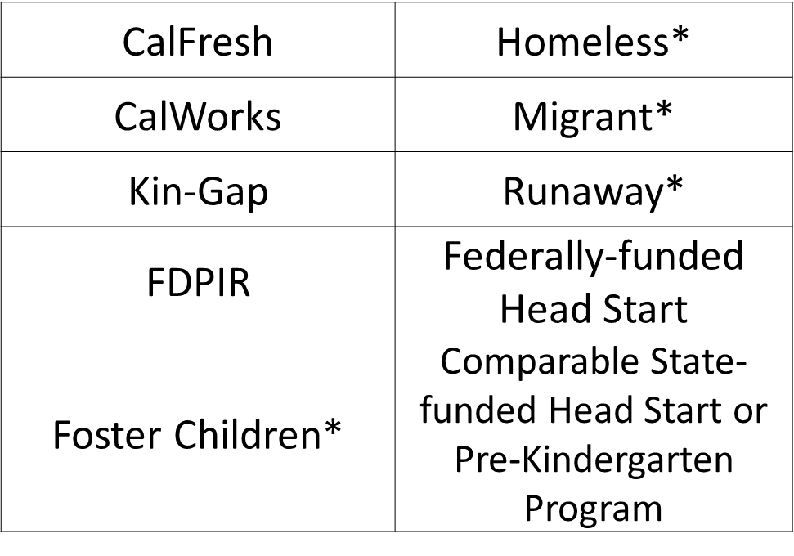
  What are Identified Students?
Identified students- are students directly certified for free school meals without the use of meal applications and not subject to verification.
  Direct certification files are obtained from the State, Country, and District*.
Notes:
Tell: What are Identified Students? Identified students are students directly certified for free school meals without the use of meal applications and not subject to verification. This means that only students matched via Direct certification files, obtained from the State, Country, and District, will be factored into the identified student total. Categorically eligible students (QQ, or any student approved via application) do not count as identified students.

Slide 8
  Eligibility Criteria
To be eligible to participate in CEP, an LEA, school or group of schools must:
  Meet the minimum identified student percentage (ISP) level of 40%
    Calculating the ISP:
      # Identified Students X 100 = Identified Student
      Enrolled Students Percentage
      ISPs may not be rounded. A percentage of 39.98 will not be rounded in any direction
Notes:
Tell: Here are the criteria that food services had to meet to implement CEP. LEAs as a whole must meet the identified student percentage (ISP) level of at least 40%. To determine the ISP, LEAs will divide the total categorically free eligible students by the total enrollment at each school or group of schools and multiply by 100. ISPs may not be rounded and a school with an ISP of 39.98 will not qualify.

Slide 9
How are Groups of Schools Formed?
A group can be formed in many ways as long as the group maintains the eligibility criteria:
  All schools in the group do not have to meet the 40% ISP, but the overall aggregate percentage of the group of schools MUST meet the 40% minimum threshold.
  LAUSD will begin CEP with 339 schools that are separated into two (2) distinct groups beginning March 1, 2016
Notes:
Tell: As mentioned in the previous slide, LEAs may group schools together in any manner that meets the overall minimum aggregate of 40%. Groupings can allow some schools with an ISP below 40% to participate, as long as the group ISP is at least 40%. There is no geographic restriction on the grouping of schools. LAUSD will begin its CEP implementation with 339 schools separated into two district groups beginning March 1, 2016.

Slide 10
Example of Forming a Group
The grouping of schools is calculated by taking the total identified students divided by the total student enrollment for that school, multiplied by 100.
    Note: Each school has its own ISP which is how you determine if the site is eligible as an individual site to move to CEP.
 | Identified students | Enrollment | ISP
School 1 | 60 | 120 | 50%
School 2 | 38 | 100 | 38%
School 3 | 150 | 200 | 75%
Group of schools | 248 | 420 | 59%
Notes:
Tell: Let’s take a look at the sample above that shows schools 1 and 3 meet the required 40% ISP but School 2 does not qualify on its own. However, if the schools were to apply as a group they would all qualify for the CEP because the combined group ISP is 59%.

Slide 11
Claiming Meals
No student co-pays are collected under CEP. Participating CEP schools are guaranteed to have the same Federal reimbursement (free or full-price) rates based on the newest ISP.
Example:
  A group of schools have an ISP of 59% x 1.6 = 94.4
    94.4% of all meals served will be reimbursed as FREE.
  Using this group; 100% - 94.4% = 5.6%
  The remaining 5.6% of all meals served will be reimbursed as FULL PRICE/PAID
There is NO Reduced Price Category.
Notes:
Tell: As mentioned in the CEP benefits slide, there are no collection of co-pays. Participating CEP schools are guaranteed to have the same Federal reimbursement (free or full-price) rates based on the newest ISP.
For example:
A group of schools with an ISP of 59% is multiplied by the factor of 1.6 and gives us a claiming percentage of 94.4
This means that 94.4% of all meals served will be reimbursed at a FREE reimbursable rate.
The remaining 5.6% of all meals will be reimbursed at full price/ paid reimbursement rate.
Notice that there is NO Reduced Price Category.
The claiming percentage is established in the first year for an LEA and may be used for 4 school years. This percentage may be increased if the percentage of identified students rises for the LEA.

Slide 12
Claiming Percentages
The claiming percentage for your school have been established for the 1st year (March 2016) and is based on the ISP of the group.
  Claiming percentage for your group will be sent to you by the Food Services Division and will be input into CMS
  The percentage will be used for 3 school years unless you are otherwise notified
    Percentages may be updated by FSD
Notes:
Tell: The claiming percentage for each school has been established for the 1st year (March 2016) and is based on the ISP of the group. The specific
Claiming percentages for each school group will be sent to out by the Food Services Division and will be input into applied within CMS.
The percentage will be used for 3 school years unless you are otherwise notified by the FSD

Slide 13
Counting and Claiming CEP
CEP allows for one (1) reimbursable meal per serving period. Meal count totals are multiplied by the free claiming percentage.
  Meal count over free percentage will be:
    Reimbursed at paid rate
    Meals must be in whole numbers
For example:
Total Meal Served= 1000
Free percentage= 59% x 1.6 = 94.4% = 944 Free
Full price percentage= 1000 - 944 = 56 Paid
Notes:
Tell:
Like all other Federal meal programs used at LAUSD, CEP will only allow for one (1) reimbursable meal per serving period. Meal count totals are multiplied by the free claiming percentage (ISP x 1.6). Any meals count over free percentage will be reimbursed at paid rate. Meals must be in whole numbers. *remember* there is no reduced price category at CEP sites.
For example:
Total Meal Served= 1000
Free percentage= 49% x 1.6 = 78.4 = 780 Free
Full price percentage= 1000 -780 = 220 Paid
Here the number of meals reimbursed at the free rate will be 780. The remaining number of meals served will be reimbursed at the free rate.
*Note* Again, there is no reduced price category under CEP

Slide 14
Non-Reimbursable Meals and
A’la Carte Sales
Students that decline to select the necessary components for a reimbursable meal, will be charged a’la carte pricing.
Children may opt out of free meals
  Bring lunch from home or purchase a’la carte items
Parents insistent on paying may donate to the non-profit school food service account
    Checks should be written to: LAUSD Cafeteria Account, with a note in the memo line “Donation for Meals at “ABC” School”
Notes:
Tell:
In the event that students that decline to select the necessary components for a reimbursable meal, they will be charged a la carte pricing. Schools may alternatively allows students to take free food, but will not be reimbursed. Children may opt out of free meals by bringing lunch from home or purchaceing a la carte pricing. Parents insistent on paying may donate to the nonprofit school food service account.

Slide 15
Transfer Students
Students transferring from a CEP school to a non-CEP school with no eligibility must be processed using a meal application within ten (10) days.
  Provide free meals to student until an eligibility is determined (10 days maximum)
Notes:
Tell: Students transferring from a CEP school to non-CEP school with no eligibility must be processed using a meal application within ten (10) days. To keep in line with the habits of the student coming from a CEP school, the non-CEP school should provide 10 days worth of free meals to the student until an eligibility is determined.
If a student transfer from a CEP school to another district’s non-CEP school they should fill out a meal application at new school as soon as possible. LAUSD encourages other districts to provide meals for 10 days to make the transition as smooth as possible by providing meals for the students.

Slide 16
Visiting Students
CEP schools should not charge visiting students for meals. Meals served to visiting students should be included in the total meal count.
Non-CEP schools hosting visiting students from a CEP schools will feed the students at no charge
  CEP school will provide the non-CEP school the claiming percentage to be used
    Non-CEP school will claim meals for visitors at the provided claiming percentage
Notes:
Tell: When students visit a CEP school, they should not be charged for a meal. Meals served to visiting students should be included in the total meal count.
Non-CEP schools hosting visiting students from CEP schools will provide free meals to avoid any disruption in the students’ meal service routine. CEP school will provide non-CEP school with claiming percentage that they will use to claim meals for reimbursement.

Slide 17
Visiting Students Example
20 Visiting Students From CEP school to Non-CEP School
  94.4% Free
  5.6% Paid
  94.4% x 20 = 18.8
  (Claim 19 Meals Free)
  5.6% x 20 = 1.12
  (Claim 1 Meal Full)
  100% Free
  Claim 20 Meals Free
20 Visiting Students From Non-CEP school to CEP School
Notes:
Here is an example for claiming visiting students
Twenty students from a CEP school visit a non-CEP school and all eat meals at no charge.
If the CEP school’s claiming percentages are 94.4 percent free and 5.6 percent paid,
these percentages are applied to the visiting student meals. The non-CEP school in this
example would claim 18 meals free (94.4% x 20) and 2 meals paid (5.6% x 20). Use standard rounding procedures to get whole numbers. If the number is 5 or more round up and if the number is 4 or less round down. The 18.8 meals would turn into 19 free meals. The 1.12 meals would turn into 1 full meal.
Non-CEP students visiting a CEP school eat all meals at no charge. All the meals will be claimed as free.

Slide 18
Record Retention Requirements
CEP will adhere to the same record retention requirements outlined by the FSD.
Maintain all monthly, weekly, and daily reports including:
  CMS Customer Roster Report
  MiSiS Meal Program Roster
  MiSiS Update Activity Report (UAR)
  CMS/MiSiS Missing Students Log
  BIC Classroom Rosters
Notes:
Tell: Schools participating in CEP will adhere to the same record retention requirements. Food Service staff will need to maintain monthly, weekly, and daily reports such as CMS Customer Roster Report, MiSiS Meal Program Roster, MiSiS update Activity Report (UAR), CMS/MiSiS Missing Students Log, and BIC Classroom Rosters.

Slide 19
Communication Strategies
Communication strategies for successful CEP implementation include:
  Placing CEP Posters and Flyers in prominent places on the school campus
  School Administration will send Flyers and Household Letters home by every student
  Marketing the CEP Program on the District, FSD and School websites
  Notifying the community via Media Events
  Creating informational packets
  Blackboard messages from the Principal
Notes:
Tell: The transition to CEP may be a significant one for parents, especially if they are familiar with filling out school meal applications each year. Participating LEAs have reported that notifying households early and often about CEP and explaining its benefits, is very important to minimize confusion about school meals at the start of the school year.
Some successful communication strategies include: Placing CEP Posters and Flyers in prominent places on the school campus, school administration sending flyers and letters home with every student, marketing the CEP Program on the District, FSD and individual school websites. Additionally, LAUSD will notify the community via media events , creating informational packets, and encouraging principals to utilize blackboard messages to reach parent e-mails.

Slide 20
  Role of the School Administrator
The school administrator’s responsibilities include:
  Collaborate with the AFSS and FS Manager to implement the provision at their school
    Distribute Flyers and Household letters
    Hang Posters at School
  Encourage school meal program participation
Notes:
Tell: School administrators will collaborate with the Food Services Division to implement CEP at their school by hanging posters in prominent locations, mailing letter and flyers home , and encouraging participation in school meal programs.
Elementary sites will receive four (4) posters and secondary sites will receive six (6).

Slide 21
CMS Modifications
The CMS technical team will update the Cafeteria Management System (CMS) settings to reflect the new established CEP counting and claiming procedure.
  FSM’s will not notice any changes to CMS-FOH
  FS staff will process students using the standard POS procedure
    Pin number
    Classroom lookup
    Manual lookup
Notes:
Tell: The central office CMS team will transition the Cafeteria Management System (CMS) settings to reflect the conversion of the previous counting and claiming procedure to the new established CEP counting and claiming procedure. At the school-sites, Food Services personnel will not notice a change and will use the standard POS procedure. They will be able to use pin numbers, classroom lookup, and manual look-up to claim meals at the point of service.

Slide 22
From Pricing to CEP
Pricing schools transitioning to CEP will adopt a collection procedure similar to the Provision 2 guidelines.
  Meal applications are not required
  No collecting of co-payments
    All students eat at no charge regardless of eligibility
  No more alternate meals
  Expect increased lunch participation
Notes:
Tell: When pricing schools transition to CEP they will adopt a collection procedure similar to the existing Provision 2 base year procedure. School sites will not collect co-pay as all students will eat at no charge. Pricing schools transitioning to CEP will no longer utilize alternate meal and as a result should expect participation to rise.

Slide 23
From Provision 2 Base Year to CEP
Schools transitioning from Provision 2 Base Year to CEP will have the same counting and claiming procedure through CMS.
  Meal applications are not required
  Expect participation counts similar to Provision 2
Notes:
Tell: For schools that are transitions from Provision 2 Base Year to CEP, there will be no change to the counting and claiming procedure at the point of service. As a reminder, meal applications are not required under CEP and schools should expect a participation counts very similar to Provision 2.

Slide 24
  Role of Area Food Services Supervisor
The Area Food Services Supervisor (AFSS) responsibilities include:
  Attend CEP training
  Notify participating CEP schools
  Provide program information to School Administrative Staff
  Ensure that correct counting and claiming procedures are followed
  Verify CMS modification occurred for each site
Notes:
Tell: Here are the responsibilities of the Area Food Services Supervisor (AFSS). They are to attend training, notify participating CEP schools, provide training to school administrative staff, ensure the correct counting and claiming procedures are followed, and verify CMS transition modification .

Slide 25
  Role of Food Service Manager
Prior to the CEP implementation, Food Services Manager’s (FSM) must attend CEP training and:
  Coordinate with the school administrator to send out flyers and letters to households by Feb 24th
  Provide CEP training to cafeteria staff Feb 24th through Feb 29th
    Trainings must include Sub FSW
  Forecast meals to accommodate potential participation increase
Notes:
Tell: The role of the Food Services Manager is an important one, they are the communication bridge with between the school sites administration and Food Services Division. The Food Services Managers responsibilities include attending CEP training, coordinating with the school site administrator on sending out informative flyers and letters to all households by February 24th. In addition, the food services manager will train all staff including sub food services worker on CEP by 29th and forecasting meals to accommodate potential increased participation.

Slide 26
  Role of Food Service Manager Cont’d
After CEP has been implemented at your site, the FSM will continue to complete daily responsibilities, including:
  Enter meal counts into CMS using both of the:
    CEP Meal Counts Report (New)
    Meal Counts Report (Current)
  Verify correct counting and claiming information after lunch service using revised CEP edit check report
  Continue to retain MISIS rosters, CMS rosters, and Update Activity Report
Notes:
Tell: The daily activities of the food service manager will be very similar to the existing daily finish line routine. The difference is the addition of the CEP Meal Counts report that will be used to retrieve the reimbursable meals during the meals and revenue portion of the production record process. We will discuss the modified role of the current meal counts report in later slides. Additionally, food service managers will verify that the counting and claiming information on the revised edit check report is accurate and maintain a detailed record of both MiSiS and CMS reports.

Slide 27
CEP Reports
All schools transitioning to CEP will utilize a combination of new and existing CMS reports to complete their daily finish line routine.
These reports include:
  CEP Meal Count Report (New)
  Meal Count Report
  Edit Check Report (Revised)
Notes:
Tell: The Manager or designee will use the counts on the CEP Meal Count report to input the reimbursable student meal counts on the production record meals tab. The manager or designee will input the adult meal counts using the counts from the standard Meal Count Report. The look of the edit check has been revised, but still serves the purpose of insuring meal compliance. Let’s take a look at these reports.

Slide 28
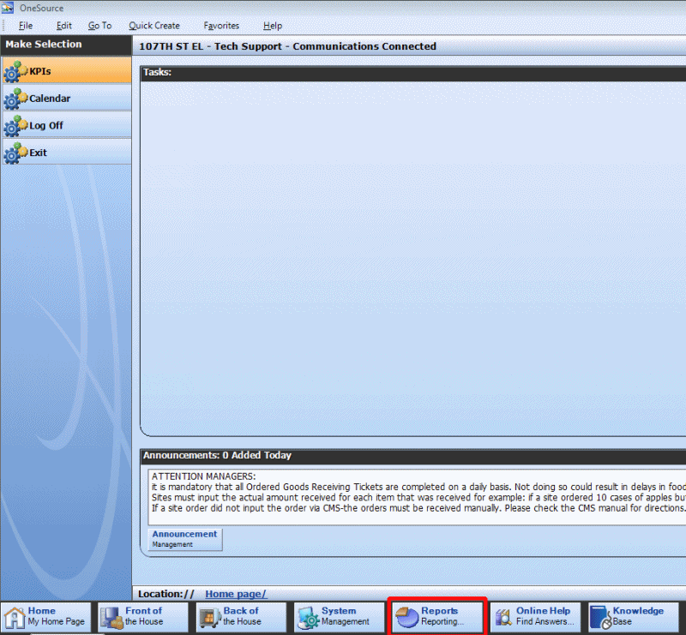
Running the New CEP Meal Count Report
Reports>Point of Service> CEP Meal Counts Form
Notes:
Tell: To run this report, managers will go to the reports section along the bottom of the CMS system screen. Next, managers will select the “Point of Service” option along the left side of the screen. When prompted, managers will select the appropriate date and preview the report. There is no need to print the report.
*****Don’t Read to Class*****
Note for presenter: This PowerPoint slide has a GIF file. The picture will loop the screenshots of the CEP report process. To go to the next slide, just continue with your normal process.

Slide 29
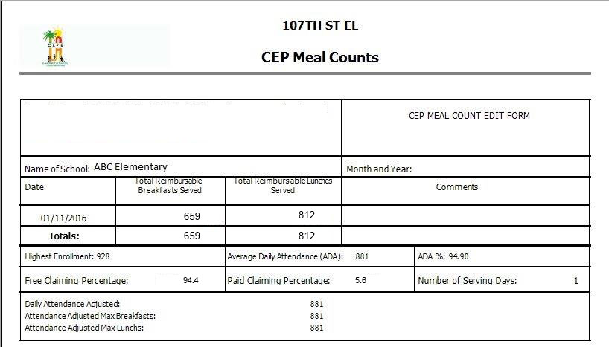
CEP Meal Count Report
ABC El.
Use the CEP Meal Count Report to obtain reimbursable student meal totals.
Notes:
Tell: Let's review the new CEP Meal Count Report. The new report will show the total reimbursable breakfast and lunch numbers. In addition, it will display the highest enrollment, average daily attendance, and ADA percentage. The claiming percentages for free and paid will help you understand your reimbursement numbers.
Managers will utilize the new CEP meal count report to obtain the reimbursable student meals total for the production record’s meal/revenue tab.

Slide 30
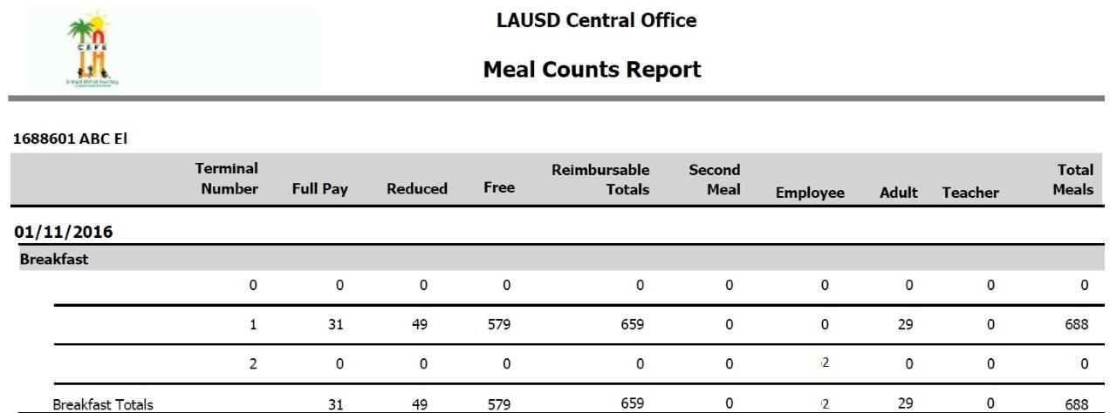
Meal Counts Report
Use the Meal Count Report to obtain adult and employee meals.
  Do not use the reimbursable totals (student totals) from this report
Notes:
Tell: We will still use the standard Meal Counts Report in our daily task. The manager only needs to obtain the “adult” and “employee” meals of the meal count report. These numbers will be used for the adult and employee sections of the meal/revenue tab.
Do not use the reimbursable totals (student totals) from this report

Slide 31
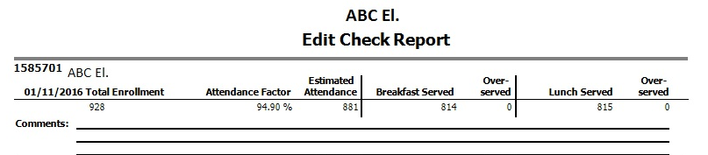
Edit Check
Edit Check Report for CEP sites will only display:
  Total Enrollment
  Attendance Factor
  Estimated Attendance
  Meals Served (Breakfast/Lunch)
  Overserved
Note: Separate meal eligibilities are no longer visible
Notes:
Tell: Here we have the new edit check report. Notice that the appearance of the edit check report has been revised and now simply shows the amount of meals served per service period and a second column will reflect the overserved meals.

Slide 32
Reapplying for a New Cycle
LAUSD is beginning a new CEP cycle effective March 1, 2016 and ending June 30, 2019.
The LEA will determine next steps regarding reapplying for a new CEP cycle in 2018-19
2015-2016
2016-2019
2019
Submit required documentation.
3-year cycle begins March 1, 2016.
Implementation of CEP. District will review ISP every year
Current CEP cycle ends, and decisions on continuing CEP occurs.
Notes:
Tell: To begin a new 4-year cycle: LEAs must establish a new ISP as of April 1st of the 4th year of the current cycle, and LEAs must continue to meet the minimum 40% ISP.
Lets review the timeline. In 2015-2016 documentation was submitted and a 4 year cycle began. During the 4 year cycle from 2015 to 2019 any increase to the ISP could be resubmitted for additional reimbursements
A new ISP must be established by April 1st of the 2019-2020 school year to begin a new 4 year cycle.

Slide 33
Questions?
Notes:
Tell: Thank you for participating in the Community Eligibility Provision training. If you have any questions please contact your AFSS or a Food Services representative.

